Slide 1
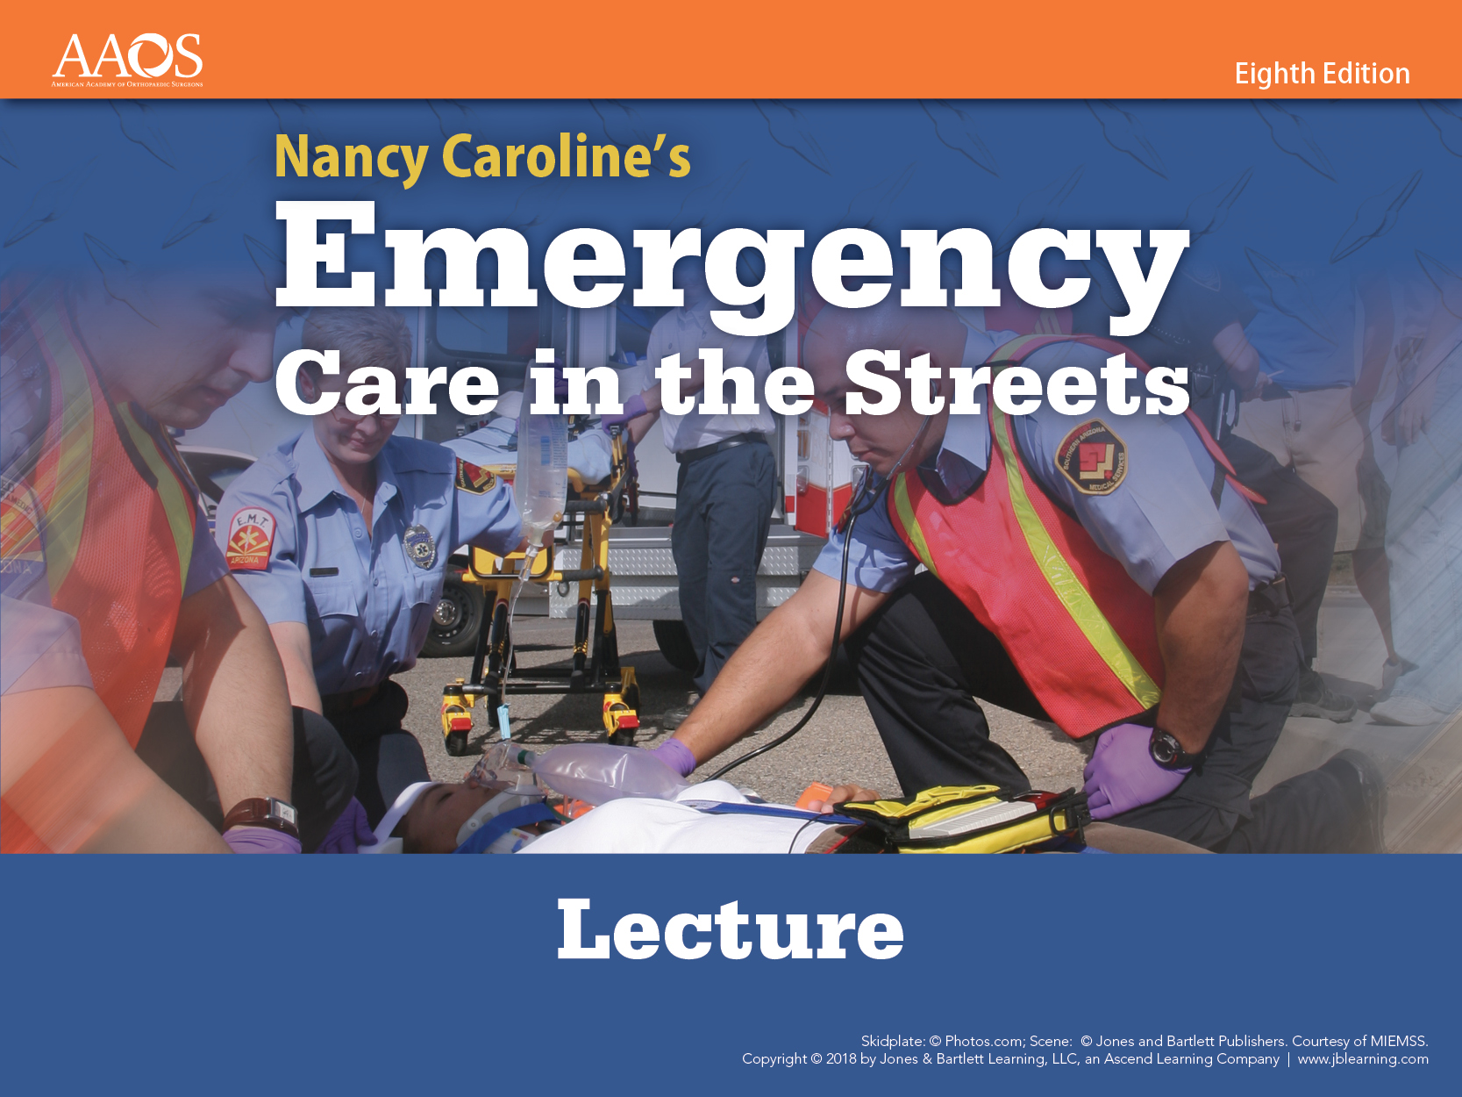
Chapter 19
Diseases of the Eyes,
Ears, Nose, and Throat
Notes:
1
Chapter 19: Diseases of the Eyes, Ears, Nose, and Throat
Comprehensive Lecture

Slide 2
National EMS Education Standard Competencies
Medicine
Integrates assessment findings with principles of epidemiology and pathophysiology to formulate a field impression and implement a comprehensive treatment/disposition plan for a patient with a medical complaint.
Notes:
2
National EMS Education Standard Competencies
Medicine
Integrates assessment findings with principles of epidemiology and pathophysiology to formulate a field impression and implement a comprehensive treatment/disposition plan for a patient with a medical complaint.

Slide 3
National EMS Education Standard Competencies
Diseases of the Eyes, Ears, Nose, and Throat
Knowledge of the anatomy, physiology, epidemiology, pathophysiology, psychosocial impact, presentations, prognosis, and management of
  Common or major diseases of the eyes, ears, nose, and throat, including nose bleed
Notes:
3
National EMS Education Standard Competencies
Diseases of the Eyes, Ears, Nose, and Throat
Knowledge of the anatomy, physiology, epidemiology, pathophysiology, psychosocial impact, presentations, prognosis, and management of
Common or major diseases of the eyes, ears, nose and throat, including nosebleed (pp 1144-1163)

Slide 4
Introduction
Calls may involve disorders of the eyes, ears, nose, and throat (EENT).
  A significant number of calls involve trauma.
  Patients may need to be transported to an emergency department with access to a specialist.
Notes:
4
Lecture Outline
I. Introduction
A. Paramedics may respond to calls involving disorders of the eyes, ears, nose, and throat (EENT).
1. A significant number of these calls involve trauma.
2. Familiarity with EENT conditions will help when assessing the patient.
a. Also allows you to educate the patient on prevention or potential care
3. Patients may need to be transported to an emergency department with access to an eye specialist or an ear, nose, and throat specialist.

Slide 5
The Eyes: Anatomy and Physiology Review
Oculomotor nerve (third cranial nerve)
  Causes motion of the eyeballs and upper eyelids
Optic nerve (second cranial nerve)
  Provides the sense of vision
Notes:
5
Lecture Outline
II. The Eyes
A. Anatomy and physiology review
1. Connection to the brain by two nerves
2. Oculomotor nerve (third cranial nerve)
a. Innervates the muscles that cause motion of the eyeballs and upper eyelids
b. Carries parasympathetic nerve fibers that cause constriction of the pupil and accommodation of the lens
3. Optic nerve (second cranial nerve)
a. Provides the sense of vision

Slide 6
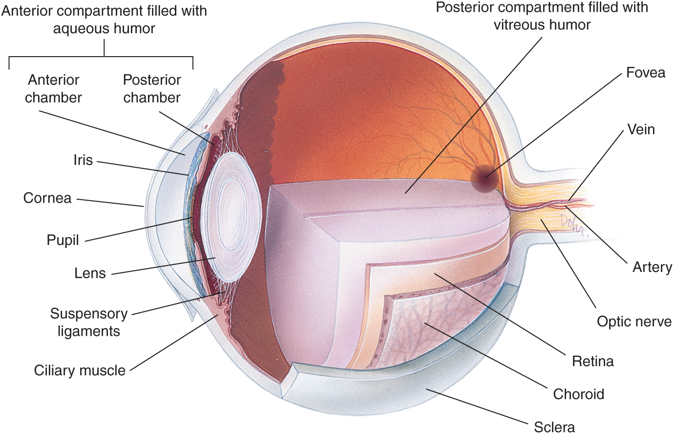
The Eyes: Anatomy and Physiology Review
© Jones & Bartlett Learning.
Notes:
6
This figure shows the structures of the eye.

Slide 7
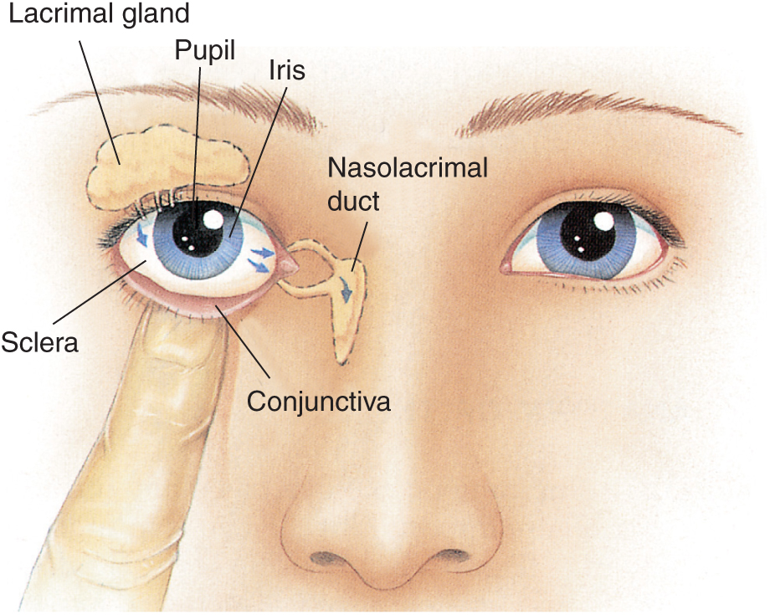
The Eyes: Anatomy and Physiology Review
© Jones & Bartlett Learning.
Notes:
7
This figure shows the lacrimal system of tear glands and ducts.

Slide 8
Patient Assessment
Ensure scene safety.
Keep your patient calm.
Form a general impression.
Assess airway and breathing.
Cover both eyes.
Consider pain management.
Cardiac monitoring is recommended.
Notes:
8
Lecture Outline
B. Patient assessment
1. Ensure scene safety.
2. Keep your patient calm.
3. Form a general impression.
a. Note environmental clues at the scene.
b. Note the approximate age and sex of the patient.
c. Note the patient’s degree of distress.
4. Assess airway and breathing.
a. Rule out life threats.
b. Do not be distracted by a swollen, irritated eye and miss priorities.
5. Early transport may improve outcomes.
6. Cover both eyes to limit damage to the affected eye through sympathetic movement.
7. Consider pain management.
8. Cardiac monitoring is recommended.
a. Ocular pressure can stimulate the vagus nerve.
b. Eye drops/medication can cause side effects such as low or high blood pressure.

Slide 9
Patient Assessment
Obtain chief complaint and history.
  OPQRST
Symptoms that may indicate a serious ocular condition include:
  Visual loss that does not improve with blinking
  Double vision
  Severe eye pain
  Foreign body sensation
Perform a thorough examination.
Notes:
9
Lecture Outline
9. Provide emotional care for the patient.
10. Obtain the chief complaint and history.
a. OPQRST
i. How and when did symptoms begin?
ii. What symptoms are experienced?
iii. Are both eyes affected?
iv. Are there any underlying diseases or conditions of the eye?
11. Symptoms that may indicate a serious ocular condition include:
a. Visual loss that does not improve when the patient blinks
b. Double vision
c. Severe eye pain
d. Foreign body sensation
12. Perform a thorough examination.
a. Use standard precautions.
b. Avoid aggravating the affected area.

Slide 10
Patient Assessment
Assess for:
  Pain/tenderness
  Swelling
  Abnormal movement or loss of movement
  Sensation changes
  Circulatory changes
  Deformity
  Visual changes
  Airway compromise
Notes:
10
Lecture Outline
c. Assess for:
i. Pain or tenderness
ii. Swelling
iii. Abnormal movement or loss of movement
iv. Sensation changes
v. Circulatory changes
vi. Deformity
vii. Visual changes
viii. Airway compromise

Slide 11
Patient Assessment
Assess structures:
  Orbital rim
    Ecchymosis, swelling, lacerations, tenderness
  Eyelids
    Ecchymosis, swelling, lacerations, abnormalities
  Corneas
    Foreign bodies
Notes:
11
Lecture Outline
13. Assess the following visible ocular structures:
a. Orbital rim
i. Ecchymosis, swelling, lacerations, tenderness
b. Eyelids
i. Ecchymosis, swelling, lacerations, abnormalities
c. Corneas
i. Foreign bodies

Slide 12
Patient Assessment
Assess structures:
  Conjunctivae
    Redness, pus, inflammation, foreign bodies
  Globes
    Redness, pigmentation, lacerations
  Eye surface
    Growths, discoloration, differences
  Pupils
    Size, shape, equality, reaction to light
Notes:
12
Lecture Outline
d. Conjunctivae
i. Redness, pus, inflammation, foreign bodies
e. Globes
i. Redness, abnormal pigmentation, lacerations
f. Eye surface
i. Growths, discoloration, differences between eyes
g. Pupils
i. PERRLA (pupils equal, round, reactive to light and accommodation)

Slide 13
Patient Assessment
When assessing ocular function, test:
  Visual acuity
    Ability to see large and small letters
  Peripheral vision
    Ability to recognize an object entering the visual field
  Ocular motility
    Ability to move the eyes in all directions
Notes:
13
Lecture Outline
14. When assessing ocular function, perform the following tests:
a. Visual acuity
i. Assess ability to see large and small letters.
ii. Test each eye separately and document results.
b. Peripheral vision
i. Test the ability to recognize an object entering the extremes of the visual field.
c. Ocular motility
i. Check the ability to move the eyes in all directions.
ii. Check for paralysis of gaze or discoordination between the movements of the two eyes (dysconjugate gaze).

Slide 14
Patient Assessment
Obtain a full set of baseline vital signs.
The patient may experience adverse effects if he or she:
  Uses more than one eye medication
  Uses too much medication
Ask how the patient administered any eye medication he or she has used.
Notes:
14
Lecture Outline
15. Obtain a full set of baseline vital signs.
a. Reassess every 5–15 minutes depending upon the patient’s condition.
16. The patient may experience adverse effects if he or she:
a. Uses more than one eye medication
b. Uses too much medication
17. Ask the patient how he or she administered any medication he or she has used.
a. Generally recommended to wait 5 minutes between the first and second drop

Slide 15
Patient Assessment
Eye drops and lubricants can be applied by:
  Gently squeezing the lower eyelid
  Applying the medication
  Having the patient close the eyes and roll them
  Applying gentle pressure to the corner of the eyes to prevent drainage
Notes:
15
Lecture Outline
18. Eye drops are used for:
a. Conjunctivitis
b. Dry, red, or itchy eyes
c. Eye pain
d. Glaucoma
e. Eye surgery
f. Herpes simplex
g. Corneal abrasions
h. Lubrication/tear production
19. Eye drops and lubricants can be applied by:
a. Gently squeezing the lower eyelid to make a pouch
b. Applying the medication into the lower lid
c. Having the patient close the eyes and roll them downward
d. Applying gentle pressure to the corner of the eyes to prevent drainage of the medication from the eye
20. Ask patients which medications they have already taken.

Slide 16
Patient Assessment
Irrigation may be necessary.
  Use sterile water or isotonic saline solution.
  Flush from the inside corner to the outside.
Eye injuries should be seen in the emergency department.
  May be irreversible
  Communicate with the patient
Notes:
16
Lecture Outline
21. Irrigation may be necessary for chemical or thermal burns.
a. Use sterile water or isotonic saline solution.
b. Flush liquid from the inside corner to the outside of the eye.
22. Eye injuries should be seen in the emergency department.
23. Eye injuries may be irreversible.
a. Communication is key to keeping the patient calm and informed.
b. Early decisions to transport can improve some outcomes.
c. Early communication with medical control can help direct your care.

Slide 17
Contact Lenses
The only indication for removing contact lenses in the prehospital setting is a chemical burn of the eye.
There are three types of contact lenses:
  Hard
  Rigid gas-permeable
  Soft (hydrophilic)
Notes:
Lecture Outline
24. Some patients will be wearing contact lenses.
a. The only indication for removing contact lenses in the prehospital setting is a chemical burn of the eye.
b. Three types of contact lenses:
i. Hard
ii. Rigid gas permeable
iii. Soft (hydrophilic)

Slide 18
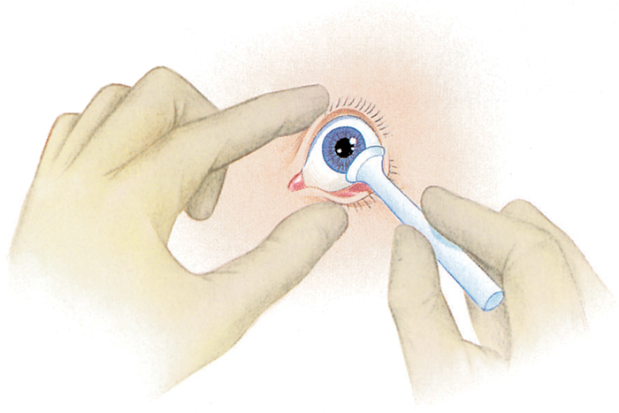
Contact Lenses
To remove hard lenses:
  Use small suction cup
  Moisten end with saline
© Jones & Bartlett Learning.
Notes:
Lecture Outline
c. To remove a hard contact lens:
i. Use a small suction cup, moistening the end with saline.

Slide 19
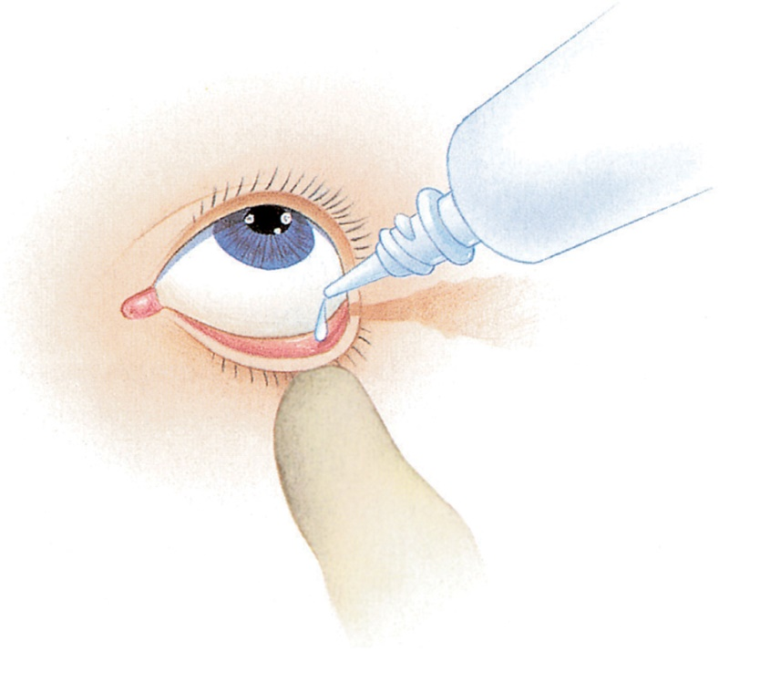
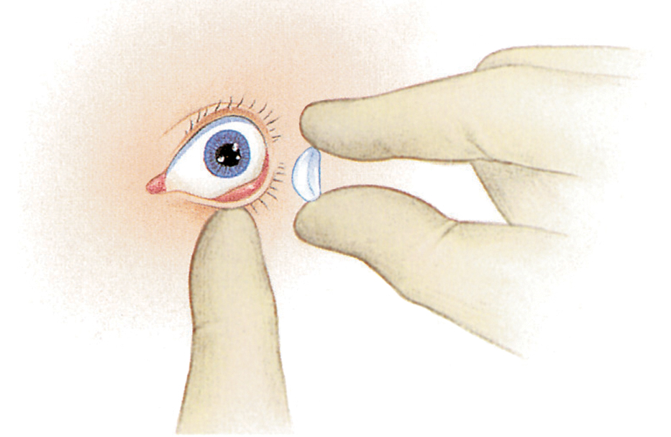
Contact Lenses
To remove soft lenses:
  Place one to two drops of saline in the eye.
  Gently pinch the lens between your fingers and lift it off the eye.
© Jones & Bartlett Learning.
© Jones & Bartlett Learning.
Notes:
Lecture Outline
d. To remove soft lenses:
i. Place one to two drops of saline in the eye.
ii. Gently pinch the lens between your gloved thumb and index finger, and lift it off the surface of the eye.
e. Advise emergency department staff if a patient is wearing contact lenses.

Slide 20
Eye Prosthesis
Suspect if the eye:
  Does not respond to light
  Does not move in concert with the opposite eye
  Does not appear quite the same as the opposite eye
Notes:
Lecture Outline
25. Suspect the patient has an eye prosthesis (artificial eye) if:
a. The eye does not respond to light.
b. The eye does not move in concert with the opposite eye.
c. The eye does not appear quite the same as the opposite eye.
d. The patient says he or she has one (if you are unsure, ask the patient).

Slide 21
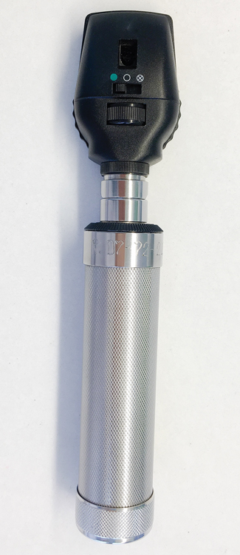
Use of Ophthalmoscope
Rarely used by paramedics
Effective evaluation requires:
  Dilation of eye
  Diagnostic expertise
© Narumon Numpha/Shutterstock.
Notes:
Lecture Outline
26. Practitioners in a hospital or physician’s office may use an ophthalmoscope.
a. Rarely used by paramedics
b. Consists of a concave mirror and a battery-powered light, usually contained in the device’s handle
c. A rotating selection of lenses and adjustable depth and magnification
d. Effective evaluation of the eye with this device requires:
i. Dilation of the patient’s pupil with medication
ii. Significant diagnostic expertise
e. Steps for use (refer to Skill Drill 19-1):
i. Darken the environment and ask the patient to look straight ahead and focus on a distant object.
ii. Set the light on the ophthalmoscope to a setting no brighter than necessary and the lens to 0, unless another setting works better for your eyes.
(a) Use your right hand and eye to examine the patient’s right eye.
(b) Use your left hand and eye to examine the patient’s left eye.
iii. Place the scope to your eye and look into the patient’ pupil from 10 to 20 inches (25 to 51 cm) away at a 45° angle to the eye.
(a) You should see the retina as a “red reflex,” or a bright orange glow.
(b) Slowly move toward the patient to appreciate the structures of the fundus.
(c) Adjust the lens as needed to improve the focus.
(d) Locate a blood vessel and follow it back to the disk.
(e) Use this blood vessel as a point of reference.
iv. Inspect for the size, color, and clarity of the disk.
(a) Note the integrity of the blood vessels and any lesions present on the retina.
(b) Move nasally to observe the macula.
(c) Repeat the process with the other eye.

Slide 22
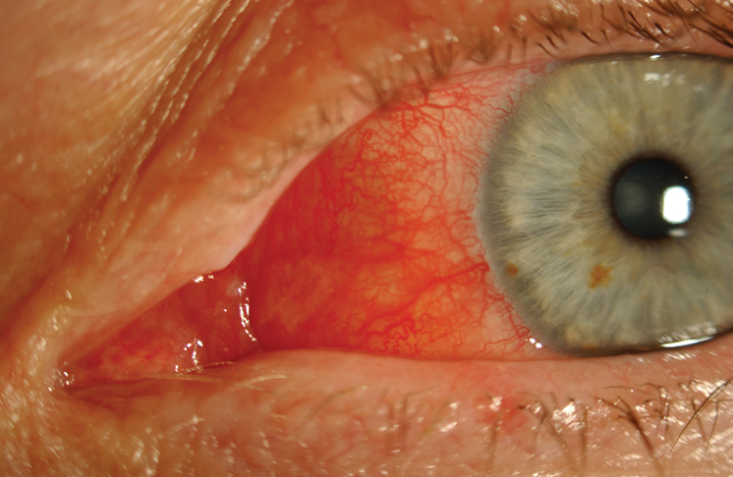
Conjunctivitis
Conjunctiva becomes inflamed and red.
  Often starts in one eye and spreads to the other eye
  Often caused by bacteria, viruses, allergies, or foreign bodies
Courtesy of John T. Halgren, M.D., University of Nebraska Medical Center.
Notes:
22
Lecture Outline
C. Pathophysiology, assessment, and management of specific eye conditions
1. Conjunctivitis (“pink eye”)
a. Condition where the conjunctiva (thin layer that lines inside of the eyelids and white of the eye) becomes inflamed and red
b. Most often starts in one eye and spread to the other eye
c. Most often caused by bacteria, viruses, allergies, chemicals, or foreign bodies
i. Viral conjunctivitis is often associated with an upper respiratory virus.
ii. Bacterial conjunctivitis is caused by bacterial infections.
iii. Viral and bacterial forms are highly contagious.
iv. Allergic conjunctivitis is caused by a trigger or irritating allergen, such as pollen.
v. Chlorine in swimming pools and air pollution are potential causes of chemical conjunctivitis.
vi. If conjunctivitis is due to a foreign body, the eye will begin to produce tears in an attempt to flush out the object.

Slide 23
Conjunctivitis
Assessment and management
  Perform a general assessment of vision.
  Viral conjunctivitis resolves on its own.
  Bacterial conjunctivitis requires topical antibiotic.
  Severe allergic conjunctivitis may need NSAIDs, antihistamines, and topical steroid eye drops.
Notes:
23
Lecture Outline
d. Assessment and management
i. Perform a general assessment of the patient’s vision.
(a) Visual acuity
(b) External eye
(c) Pupils
(d) Peripheral vision
(e) Eye movement
ii. Viral conjunctivitis normally resolves on its own.
iii. Bacterial conjunctivitis requires a topical antibiotic.
iv. Severe allergic conjunctivitis may need nonsteroidal anti-inflammatory drugs (NSAIDs), antihistamines, and topical steroid eye drops.

Slide 24
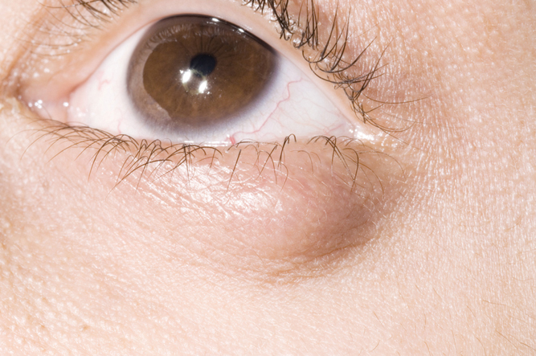
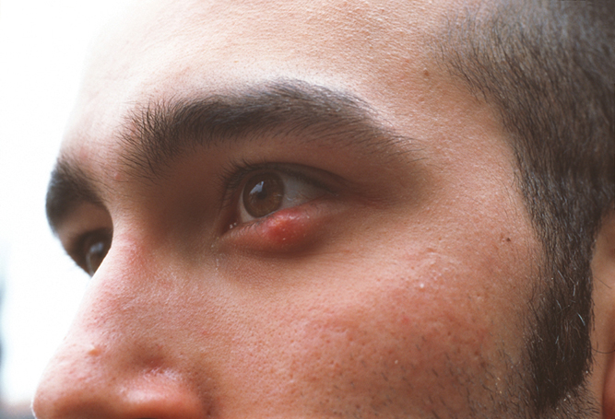
Inflammation of the Eyelid (Chalazion and Hordeolum)
Chalazion: swollen bump or pustule on the external eyelid
  Formed by blockage of oil gland
Hordeolum (stye): red, tender lump in eyelid or lid margin
  Infection of oil gland
© Dr. P. Marazzi/Photo Researchers, Inc.
© Francoise Sauze/Photo Researchers, Inc.
Notes:
24
Lecture Outline
2. Inflammation of the eyelid (chalazion and hordeolum)
a. A protective film of oil glands and oil ducts across the eye
i. Chalazion: Small swollen bump or pustule on the external eyelid formed by blockage and swelling of oil gland
ii. Hordeolum: Infection of an oil gland that produces a red tender lump in the eyelid or at the lid margin
(a) Commonly known as a stye

Slide 25
Inflammation of the Eyelid (Chalazion and Hordeolum)
Assessment and management
  Thorough assessment of vital signs and history is warranted.
  Transport to the emergency department.
  Patient may be asked to treat inflammation with a warm washcloth.
  Topical or oral antibiotics may be prescribed.
Notes:
25
Lecture Outline
b. Assessment and management
i. A thorough assessment of vital signs, history, and transport for physician evaluation is warranted.
ii. The patient will usually be asked to apply warm compresses for 5 to 10 minutes several times a day.
iii. Topical or oral antibiotics may be prescribed.

Slide 26
Glaucoma
Group of conditions that lead to increased intraocular pressure
  Open-angle glaucoma
  Normal-tension glaucoma
  Narrow-angle glaucoma
  Secondary glaucoma
Usually treated with eye drops to reduce ocular pressures
Notes:
26
Lecture Outline
3. Glaucoma
a. Group of conditions that lead to increased intraocular pressure
i. One of the leading causes of blindness
b. Aqueous humor
i. Clear, watery fluid that fills the eye’s anterior chamber
ii. Maintains intraocular pressure, provides nutrients to the inner surface of the eye, and helps to bend light
iii. Circulates through the pupil and drains into the venous system by the canal of Schlemm
c. Several types of glaucoma
i. Open-angle glaucoma
(a) Aqueous fluid drains too slowly.
(b) Pressure builds up within the eye and damages the optic nerve.
(c) This is the most common type of glaucoma.
ii. Normal-tension glaucoma
(a) Can cause vision changes with no increase in intraocular pressure
iii. Narrow-angle glaucoma (also called angle-closure glaucoma)
(a) Aqueous fluid does not drain properly due to narrowing of the drainage channel.
(b) Pressure builds up in the posterior chamber of the eye, which pushes the lens forward.
(c) The lens pushes the iris into the drainage channel, completely blocking it.
d. Secondary glaucoma is a result of conditions that damage the drainage channel in the eye
i. Diabetes
ii. Eye injuries
iii. Leukemia
iv. Sickle cell anemia
v. Some types of arthritis
vi. Cataracts
e. Increases with age
f. Usually treated with eye drops to reduce ocular pressures

Slide 27
Glaucoma
Assessment and management
  Rule out trauma or physical injury.
  Perform a general eye assessment.
  Document pertinent negatives and abnormal findings.
  An ophthalmologist will perform a more comprehensive assessment.
Notes:
27
Lecture Outline
g. Assessment and management
i. Patient complaints may involve:
(a) Loss of field of vision (specifically peripheral vision)
ii. Patients who have an acute attack of narrow-angle glaucoma may report:
(a) Severe eye pain
(b) Headache
(c) Photophobia
(d) Nausea and vomiting
(e) Blurred vision
(f) Halos around lights
iii. The cornea may look cloudy and pupils often have irregular margins and can be fixed in mid-position and dilated.
iv. Acute narrow-angle glaucoma is a medical emergency.
v. Rule out trauma or physical injury.
vi. Perform a general eye assessment.
(a) Document pertinent negatives and abnormal findings.
(b) An ophthalmologist will perform a more comprehensive assessment.
(1) All patients with eye injuries or conditions should be taken to the emergency department for follow-up.

Slide 28
Central Retinal Artery Occlusion
Blood supply to the retina becomes blocked.
A central retinal artery occlusion may cause temporary or permanent partial blindness.
A situation involving rapid loss of vision is an emergency and requires immediate transport.
Notes:
Lecture Outline
4. Central retinal artery occlusion
a. Condition in which the blood supply to the retina becomes blocked because of a clot or embolus in the central retinal artery or one of its branches
b. Possible causes: embolus from the carotid artery, valvular heart disease, drug abuse, fat emboli, arterial spasm, and oral contraceptive use
c. May cause partial blindness, which may be temporary or permanent
d. Assessment and management
i. Patients with central retinal artery occlusion usually seek medical assistance because of a sudden, painless loss of vision in one eye.
(a) Symptoms may be preceded by flickering or a transient loss of vision weeks or months before the acute event.
ii. Vision loss in central retinal vein occlusion may progress over 30 to 120 minutes.
e. Immediate transport in a situation involving a rapid loss of vision

Slide 29
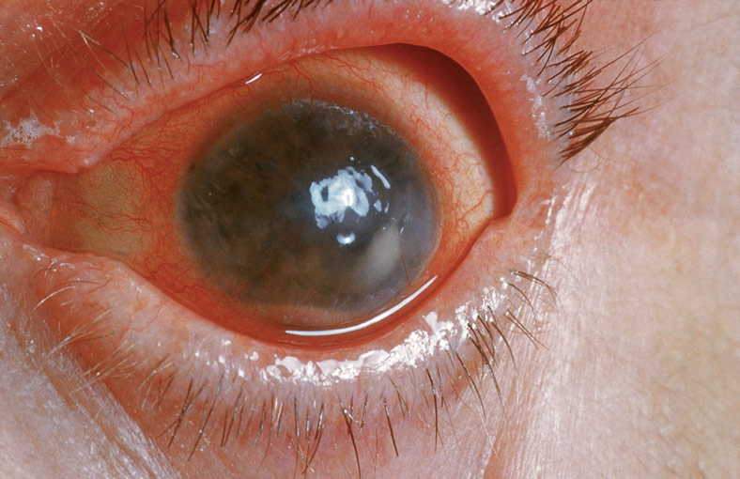
Iritis
Inflammation of the iris
  Acute causes:
    Trauma
    Irritants
  Chronic causes:
    Autoimmune diseases
    Arthritis
    Irritable bowel disease
    Crohn’s disease
© Biophoto Associates/Photo Researchers, Inc.
Notes:
29
Lecture Outline
5. Iritis
a. Inflammation of the iris
b. Also called anterior uveitis
c. Third leading preventable cause of blindness
d. Can be acute or chronic
i. Acute—caused by trauma or irritants and usually affects only one eye
ii. Chronic causes include:
(a) Autoimmune diseases
(b) Different types of arthritis
(c) Irritable bowel disease
(d) Crohn’s disease
iii. Infectious causes include:
(a) Lyme disease
(b) Tuberculosis
(c) Sexually transmitted diseases

Slide 30
Iritis
Assessment and management
  Iritis is a red area surrounding the iris, cloudy vision, or an unusually shaped pupil.
  Focus on history.
    Acute iritis may respond to topical corticosteroids.
    Chronic iritis should be referred to a specialist.
Notes:
30
Lecture Outline
e. Assessment and management
i. Iritis presents as a red area surrounding the iris, cloudy vision, or an unusually shaped pupil.
ii. Focus on history.
(a) Patients should be directed to a uveitis specialist or an ocular immunologist.
iii. Acute iritis usually responds well to topical corticosteroids as long as the cause is not fungal, viral, or bacterial.
iv. Ninety different pathogens or autoimmune processes can cause chronic or recurrent iritis.
(a) Patients should be referred to a specialist.
(b) Iritis can result in permanent disability if left untreated.

Slide 31
Papilledema
Swelling or inflammation of the optic nerve
Symptoms:
  Headaches
  Nausea
  Temporary vision loss or narrowing vision fields
  Graying in the field of vision
Notes:
31
Lecture Outline
6. Papilledema
a. Results from swelling or inflammation of the optic nerve at the rear part of the eye
b. Symptoms:
i. Headaches
ii. Nausea with possible vomiting
iii. Temporary vision loss or narrowing vision fields
iv. A graying in the field of vision

Slide 32
Papilledema
Can be caused by:
  Abscess
  Tumor
  Inner ear infection
  Lung infection
  Dental infection
Other causes:
  Meningitis
  Fever
  Hypertensive crisis
  Chronic high blood pressure
  Guillain-Barré syndrome
Notes:
32
Lecture Outline
c. Can be caused by:
i. Abscess
ii. Tumor
iii. Inner ear infection
iv. Lung infection
v. Dental infection
vi. Other causes:
(a) Meningitis
(b) Fever
(c) Hypertensive crisis
(d) Chronic high blood pressure
(e) Guillain-Barré syndrome

Slide 33
Papilledema
Assessment and management
  Prehospital management consists of:
    Treating symptoms.
    Transporting.
    Assessing ABCs and life threats.
    Administering analgesics or a mild sedative, if needed.
Notes:
33
Lecture Outline
d. Assessment and management
i. Diagnosis will be made by an ophthalmologist or physician.
ii. Prehospital management consists of:
(a) Treating symptoms.
(b) Transporting.
(c) Assessing ABCs.
(d) Assessing for life threats.
(e) Administering analgesics or a mild sedative, if needed.

Slide 34
Cellulitis of the Orbit
Periorbital cellulitis
  Presents as painful, red, swollen eyelid
  Risk factors:
    Insect bites
    Upper respiratory disorders
    Trauma
Orbital cellulitis
  Medical emergency
  Risk factors:
    Sinusitis
    Tooth infections
    Ear infections
    Trauma
    Sinus infections
Notes:
34
Lecture Outline
7. Cellulitis of the orbit: Periorbital and orbital cellulitis
a. Commonly caused by Staphylococcus and Streptococcus bacterial infections
b. Periorbital cellulitis
i. More prevalent in children than adults
ii. Also known as preseptal cellulitis or eyelid cellulitis
iii. Presents as a painful, red, swollen eyelid
iv. Fever
v. Redness of part of the white part of the eyes
vi. Predisposed risk factors:
(a) Insect bites
(b) Upper respiratory disorders
(c) Trauma
c. Orbital cellulitis
i. An infection within the eye socket
ii. Considered a medical emergency
iii. Goal of treatment: to avoid the formation of an abscess
iv. Predisposed risk factors:
(a) Sinusitis
(b) Tooth infections
(c) Facial or middle ear infections
(d) Trauma
(e) Sinus infections

Slide 35
Cellulitis of the Orbit
Assessment and management
  Treatment includes antibiotics.
  Prehospital management includes:
    Ruling out life threats
    Obtaining a thorough history
    Transporting to the appropriate care site
Notes:
35
Lecture Outline
d. Assessment and management
i. Treatment in children is usually IV antibiotics.
ii. Adults are generally treated with oral antibiotics.
iii. Prehospital management includes:
(a) Ruling out life threats
(b) Obtaining a thorough history
(c) Transporting the patient to the appropriate care site

Slide 36
Corneal Abrasion
Most common eye injury
  Caused by direct trauma, foreign bodies, contact lenses, or exposure to ultraviolet radiation
Ulcer development without prompt treatment
  Can cause blindness if left untreated
Notes:
36
Lecture Outline
8. Corneal abrasion or ulcer
a. Cornea: a transparent outer covering of the eye
b. The most common eye injury seen in emergency departments
i. Caused by direct trauma, foreign bodies, contact lenses, or exposure to ultraviolet radiation
c. Ulcer development without prompt treatment
i. Can cause blindness if left untreated.

Slide 37
Corneal Abrasion
Assessment
  Symptoms include:
    Pain
    Redness
    Tearing
    Feeling of something in eye
    Blurred vision or loss of vision
    Photophobia
    Headache
Notes:
37
Lecture Outline
d. Assessment and management
i. Symptoms include:
(a) Pain with extraocular movement
(b) Redness
(c) Excessive tearing
(d) Sensation of having something foreign in the eye
(e) Blurred vision or loss of vision
(f) Photophobia
(g) Headache

Slide 38
Corneal Abrasion
Management
  Rule out life threats.
  Take a thorough history.
  Transport promptly.
Notes:
Lecture Outline
ii. Prehospital management
(a) Rule out life threats.
(b) Take a thorough history.
(c) Transport promptly.

Slide 39
The Ears
The ears are the primary structures for hearing and balance.
  Disorders and injuries can leave a person unable to:
    Communicate
    React
    Maintain equilibrium
Notes:
39
Lecture Outline
III. The Ears
A. The primary structures for hearing and balance
1. Disorders and injuries can leave a person unable to communicate, react, and maintain equilibrium.
a. Changes in air pressure can cause ear discomfort.
b. Tumors on cranial nerves can affect the inner ear and balance, facial sensation, eye movement, facial movement, taste, and hearing.

Slide 40
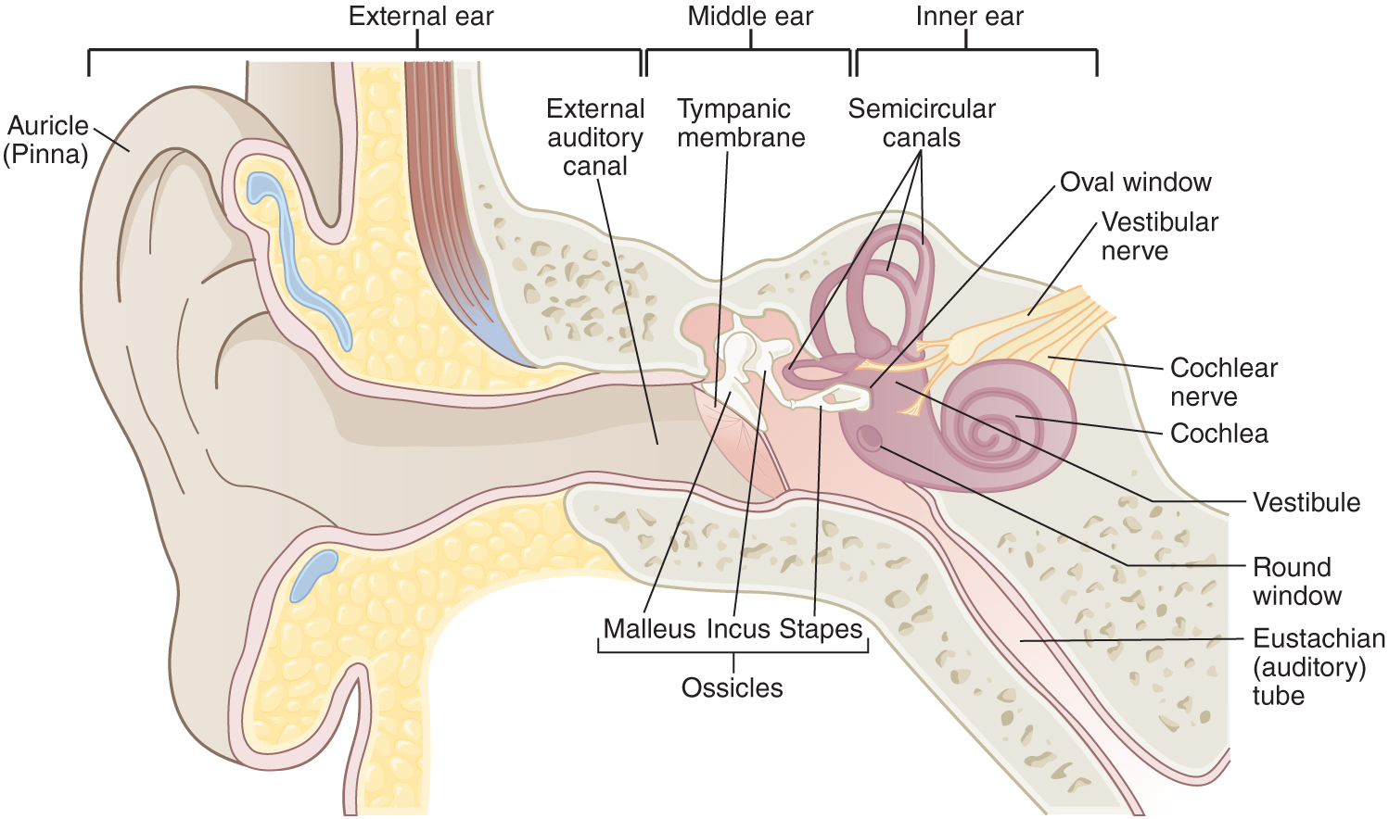
Anatomy and Physiology Review
The ear is divided into three anatomic parts.
© Jones & Bartlett Learning.
Notes:
40
Lecture Outline
B. Anatomy and physiology review
1. The ear is divided into three anatomic parts.
a. External ear
i. Pinna
ii. External auditory canal
iii. External portion of the tympanic membrane (eardrum)
b. Middle ear
i. Inner portion of the tympanic membrane
ii. Ossicles
c. Inner ear
i. Cochlea
ii. Semicircular canals

Slide 41
Anatomy and Physiology Review
Sound waves travel through the ear and internal ear structures from nerve impulses that travel to the brain via the auditory nerve.
  The brain converts these impulses into sound.
Notes:
41
Lecture Outline
2. Sound waves travel through the ear, and then the internal ear structures form nerve impulses that travel to the brain via the auditory nerve.
a. The brain converts these impulses into sound.

Slide 42
Patient Assessment
Observe the scene for hazards.
As you approach, assess:
  Age and sex of the patient
  Environmental conditions
  Degree of distress
  Presence of hearing aid
Notes:
42
Lecture Outline
C. Patient assessment
1. Possible ear injuries include the following:
a. Foreign objects forced into the auditory canal can damage the eardrum.
b. Ear infections may cause the eardrum to blister and bleed; inner ear infections may cause pressure behind the eardrum.
c. Blast pressure waves can burst the eardrum.
2. Observe the scene to rule out hazards to EMS personnel and crew.
3. As you approach, assess:
a. Approximate age and sex of the patient
b. Environmental conditions
c. Patient’s degree of distress
d. Whether the patient is wearing a hearing aid

Slide 43
Patient Assessment
Ensure ABCs and manage life threats.
Take a complete history.
Observe ears for:
  Drainage
  Excess cerumen
  Inflammation
  Swelling
Notes:
43
Lecture Outline
4. Ensure airway patency, breathing adequacy, and circulation.
5. Manage life threats.
6. Take a complete history.
7. Observe ears for:
a. Drainage
b. Excess cerumen (earwax)
c. Inflammation
d. Swelling

Slide 44
Patient Assessment
Have the patient rate his or her pain.
Ask about:
  Changes in hearing
  Tinnitus
  Dizziness
Inspect for:
  Wounds
  Swelling
  Drainage
  Battle sign of the mastoid process
Notes:
44
Lecture Outline
8. Have the patient rate his or her pain using OPQRST.
a. Include pertinent negatives.
9. Ask the patient about:
a. Changes in hearing
b. Tinnitus (ringing in the ears)
c. Dizziness
10. Inspect and palpate for:
a. Wounds
b. Swelling
c. Drainage
i. Pus
ii. Blood
iii. Cerebrospinal fluid
d. Battle sign (discoloration and tenderness) of the mastoid process of the skull

Slide 45
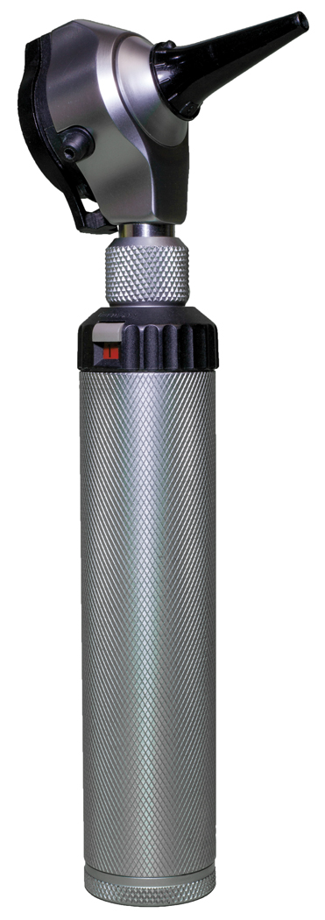
Use of an Otoscope
Used to visualize abnormalities of the external canal and tympanic membrane
  Paramedics must work in expanded scope of practice.
© Terayut Janjaranuphab/Shutterstock.
Notes:
Lecture Outline
11. An otoscope is used to visualize abnormalities of the external canal and tympanic membrane.
a. An otoscope consists of a head and a handle.
i. The head contains an electric light source and a low-power magnifying lens.
ii. The front of the headpiece has an attachment for a disposable plastic earpiece (speculum).
b. The examiner inserts the speculum into the ear and looks through a lens on the rear of the headpiece.
c. Typically, paramedics must work in an expanded scope of practice and receive additional training from their medical director to use an otoscope.
d. Refer to Skill Drill 19-2.
12. Even if you are trained in the use of an otoscope and it is included in your scope of practice, transport the patient to receive a complete assessment of the external ear canal and middle ear.
13. Document and communicate your findings.

Slide 46
Impacted Cerumen
Yellowish oily substance found in ear canal
May present as:
  Wet: a sticky brown color
  Dry: a grayish flaky substance
Can become impacted and cause pressure on eardrum
Notes:
46
Lecture Outline
D. Pathophysiology, assessment, and management of specific ear conditions
1. Impacted cerumen
a. Yellowish, oily substance found in the outer ear canal (earwax)
i. Helps prevent dirt and water from entering the middle ear canal and may protect the ear from bacteria or fungus
ii. May present as:
(a) Wet—a sticky brown color
(b) Dry—a grayish flaky substance
iii. Can become impacted and cause pressure against the eardrum

Slide 47
Impacted Cerumen
Risk factors include:
  Abnormal ear canal shape
  Diseases that cause increased cerumen
  Improper use of cotton swabs
Notes:
47
Lecture Outline
b. More common in older adults
c. Other risk factors:
i. Abnormal ear canal shape
ii. Diseases that cause increased production of cerumen
(a) Keratosis
iii. Improper use of cotton swabs
d. Assessment and management
i. Symptoms:
(a) Sensation of pressure or fullness in the ears
(b) Dizziness
(c) Ringing in the ears
(d) Loss of hearing
(e) Pain or itching in the ears

Slide 48
Impacted Cerumen
Assessment and management
  Symptoms may include:
    Pressure or fullness in the ears
    Ringing in the ears
    Loss of hearing
    Pain or itching
  Prehospital treatment includes:
    Thorough history
    Visual inspection of the ear
Notes:
48
Lecture Outline
e. Prehospital treatment includes:
i. Thorough history
ii. Visual inspection of the ear
f. Treatment is aimed at removing the excess cerumen.
i. Do not attempt to extract the material yourself.
ii. If left untreated, infection and irritation can occur.
iii. Follow-up is necessary.

Slide 49
Labyrinthitis
Feeling of vertigo or loss of balance after an ear infection or upper respiratory infection
Effect on the nerves from irritation and swelling
  Symptoms may include:
    Loss of balance
    Ringing in the ears
    Loss of hearing
    Vomiting
Notes:
49
Lecture Outline
2. Labyrinthitis
a. Most commonly recognized as the feeling of vertigo or loss of balance after an ear infection or upper respiratory infection
b. Effect on the nerves of the inner ear and a loss of balance from irritation and swelling of the inner ear
c. Other symptoms:
i. Ringing in the ears
ii. Dizziness
iii. Loss of hearing
iv. Nausea
v. Vomiting

Slide 50
Labyrinthitis
Assessment and management
  Prehospital treatment is directed at:
    Reducing nausea and vomiting
    Transporting the patient in a position of comfort
  Serious disorders will need to be ruled out by a CT scan and an MRI.
Notes:
50
Lecture Outline
d. Assessment and management
i. Prehospital treatment is directed at:
(a) Reducing the severity of the nausea and vomiting
(b) Transporting the patient in a position of comfort
ii. Serious disorders will need to be ruled out by a CT scan and an MRI.
iii. Hospital treatment includes:
(a) Antiemetic for nausea and vomiting
(b) Antihistamine for swelling
(c) Antivertigo medicine
(d) Diazepam as sedative

Slide 51
Meniere Disease
Chronic condition characterized by:
  Dizziness described as spinning vertigo
  Low-frequency hearing loss
  Tinnitus
  Feeling of fullness in the affected ear
Overproduction and defective absorption of endolymphatic fluid
  Increases volume and pressure within the inner ear
Notes:
51
Lecture Outline
3. Meniere disease
a. Chronic condition of the inner ear characterized by:
i. Dizziness described as spinning vertigo
ii. Low-frequency hearing loss
iii. Tinnitus
iv. Feeling of fullness in the affected ear
b. Involves the overproduction and defective absorption of endolymphatic fluid, which increases the volume and pressure within the labyrinth of the inner ear
i. Distention results in rupture and mixing of the endolymph and perilymph fluids.
ii. This mixture disrupts the balance of fluid and electrolytes within the labyrinth and damages the vestibular and cochlear hair cells.
c. Attacks of less than 2 hours in the early stages; altered balance up to 2 days
i. As the disease progresses, symptoms last hours to days.
ii. Permanent tinnitus, moderate to severe hearing loss, and chronic unsteadiness may result.

Slide 52
Meniere Disease
Assessment and management
  Prehospital care includes an antiemetic.
  Physician may treat with diuretics and an antiemetic.
Notes:
52
Lecture Outline
d. Assessment and management
i. Prehospital care includes treating the nausea and vomiting with an antiemetic.
iii. The physician may treat with diuretics and an antiemetic.

Slide 53
Otitis Externa and Media
Infection resulting from bacterial growth in the ear canal
  Otitis externa—outer ear
  Otitis media—middle ear
More common in children than adults
Notes:
53
Lecture Outline
4. Otitis externa and media
a. Infection that results from bacterial growth in the ear canal
i. Otitis externa—infection of the outer ear
ii. Otitis media—infection of the middle ear
b. More common in children than adults
c. Most commonly bacterial infections
i. Otitis externa can also be an allergic or fungal reaction.
ii. Otitis media can be virally induced.

Slide 54
Otitis Externa and Media
Assessment and management
  Signs and symptoms may include:
    Edema and erythema
    Diminished hearing acuity
    Inflamed, bulging tympanic membrane
  Prehospital treatment includes relieving unbearable symptoms.
Notes:
54
Lecture Outline
d. Assessment and management
i. Signs and symptoms:
(a) Pain
(b) Itching
(c) Edema and erythema
(d) Diminished hearing acuity
(e) Inflamed, bulging tympanic membrane on exam with otoscope
ii. Prehospital treatment should be directed at relieving unbearable symptoms.
(a) Monitor the patient’s condition and administer pain medication when necessary.
iii. In the hospital setting, antibiotics may be administered.
(a) If symptoms do not improve, tympanocentesis (needle aspiration) may be performed.

Slide 55
The Nose
The nose is susceptible to injury because of its prominence.
  Allergens, particles, and chemicals can cause inflammation, infection, and injury.
Inside of the nose is extremely vascular.
  Excellent route for some medicines.
Notes:
55
Lecture Outline
IV. The Nose
A. Susceptible to injury because of prominent location on the face
1. The nose acts as a filter, humidifier, and heater for air that enters the body.
2. Allergens, particles, and chemicals can cause inflammation, infection, and injury.
a. Complications from nasal disorders are common.
i. Can lead to systemic infections
3. The inside of the nose is extremely vascular.
a. Excellent route for some medicines
i. Faster than intravenous administration

Slide 56
The Nose
Smelling disorders include:
  Anosmia (total loss of sense of smell)
  Dysosmia (distorted sense of smell)
  Hyperosmia (increased sensitivity to smell)
  Hyposmia (decreased sense of smell)
  Presbyosmia (loss of smell from normal aging)
Notes:
56
Lecture Outline
4. Loss of smelling sensation has many causes.
a. Aging, smoking, allergies, rhinitis, polyps, flu, medications, traumatic brain injury
b. Smelling disorders
i. Anosmia (total loss of sense of smell)
ii. Dysosmia (distorted sense of smell)
iii. Hyperosmia (increased sensitivity to smell)
iv. Hyposmia (decreased sense of smell)
v. Presbyosmia (loss of smell from normal aging)

Slide 57
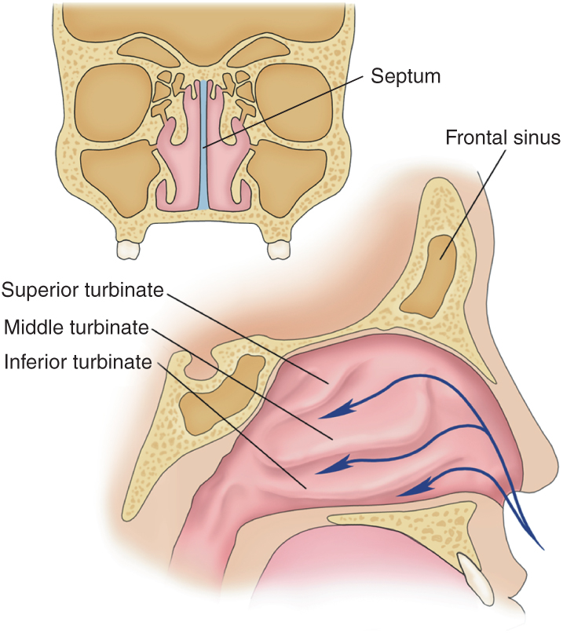
Anatomy and Physiology Review
One of two primary entry points for oxygen
Warms and humidifies air as it enters the body
© Jones & Bartlett Learning.
Notes:
57
Lecture Outline
B. Anatomy and physiology review
1. One of two primary entry points for oxygen
2. Warms and humidifies air as it enters the body

Slide 58
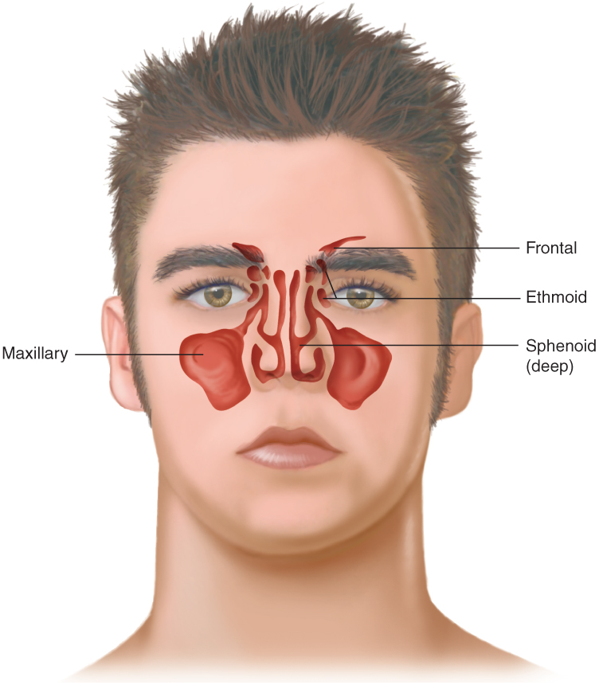
Anatomy and Physiology Review
Contains bony structures
Connected with the sinuses
© Jones & Bartlett Learning.
Notes:
58
Lecture Outline
3. Contains bony structures
4. Connected with the sinuses

Slide 59
Patient Assessment
Look for environmental clues.
Ensure scene safety.
Assess airway and breathing.
Determine level of distress.
Nasal cavities are prone to bleeding.
Notes:
59
Lecture Outline
C. Patient assessment
1. Look for environmental clues.
2. Ensure that the scene is safe.
3. Determine whether airway and breathing are sufficient.
4. Determine the patient’s level of distress.
5. The vascular nature of the nasal cavities makes them susceptible to bleeding.
a. A severe nosebleed or condition that blocks the airway with swelling or blood is a life-threatening condition.

Slide 60
Patient Assessment
Insert an airway adjunct as needed.
  Do not insert a nasopharyngeal airway or attempt nasotracheal intubation with:
    Suspected nasal fractures
    CSF or blood leakage from the nose
  Inquire about the patient’s history of nose conditions.
Notes:
60
Lecture Outline
6. Insert an airway adjunct as needed.
a. Do not insert a nasopharyngeal airway or attempt nasotracheal intubation in any patient with:
i. Suspected nasal fractures
ii. CSF or blood leakage from the nose
7. Inquire about a previous history of nose conditions or bleeding.
8. Always consider a hypertensive crisis when an older person has a nosebleed.

Slide 61
Epistaxis
Nosebleed
  Causes
    Digital trauma
    Dryness
    Hypertension
Notes:
61
Lecture Outline
D. Pathophysiology, assessment, and management of specific nose conditions
1. Epistaxis
a. Nosebleed
b. Most common cause digital trauma
c. Other causes include:
i. Dryness
ii. Hypertension

Slide 62
Epistaxis
Anterior
  Bleed fairly slowly
  Self-limiting and resolve quickly
Posterior
  More severe
  Often cause blood to drain into the throat, causing nausea and vomiting
Notes:
Lecture Outline
d. Two types
i. Anterior
(a) Most typically occur in the Kiesselbach plexus
(b) Usually self-limiting and resolve quickly
ii. Posterior
(a) Usually more severe
(b) Often cause blood to drain into the patient’s throat, causing nausea and vomiting

Slide 63
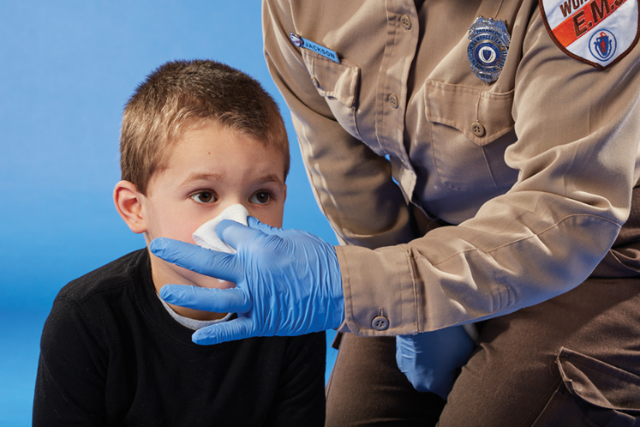
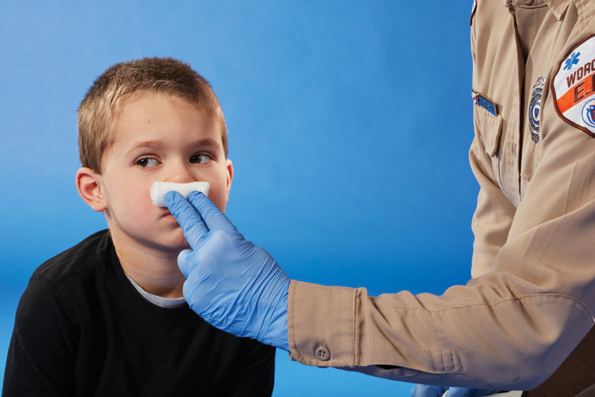
Epistaxis
Assessment and management:
  Try to estimate blood loss.
  Place a nontrauma patient in a sitting position and pinch nostrils together.
  Direct the patient not to sniff or blow his or her nose.
© Jones & Bartlett Learning.
© Jones & Bartlett Learning.
Notes:
63
Lecture Outline
e. Assessment and management
i. Try to estimate the amount of blood loss and relay this information to the staff at the receiving facility.
ii. Place a nontrauma patient in a sitting position, leaning forward, and pinch his or her nostrils together.
ii. Direct the patient not to sniff or blow his or her nose.

Slide 64
Foreign Body
A foreign body is most likely to be seen in pediatric patients.
Pressure in the nasal passage can cause:
  Tissue necrosis
  Inflammation
  Swelling
Inflammation can cause tissue ulceration and epistaxis.
Nasal blockage can lead to sinusitis.
Notes:
64
Lecture Outline
2. Foreign body
a. Most likely to be seen in pediatric patients
b. Pressure in the nasal passage can cause:
i. Tissue necrosis
ii. Inflammation
iii. Swelling
c. Tissue ulceration and epistaxis caused by inflammation
d. Sinusitis caused by nasal blockage

Slide 65
Foreign Body
Assessment and management
  Determine if condition is life-threatening.
  Any persistent, foul-smelling, purulent discharge should lead to suspicion.
    Let discharge drain.
  Transport the patient in a position of comfort.
Notes:
65
Lecture Outline
e. Assessment and management
i. Determine if the foreign body presents a life-threatening condition.
ii. You may be able to see only one end of the object or not see it at all.
iii. Any persistent, foul-smelling, purulent discharge from the nares should lead to suspicion of a foreign body.
(a) If you note discharge from the nose, let it drain.
iv. Transport the patient in a position of comfort.
(a) Limit the ability of gravity to introduce the object further into the cavity.
(b) Prevent aspiration.
v. Pain management or sedation may be necessary.
(a) Consultation with medical control is advised.

Slide 66
Rhinitis
Inflammation of the nasal cavity
May be caused by:
  Bacterial infection
  Viral infection
  Allergens
  Medications
  Changes in environmental temperature
  Other factors
Notes:
66
Lecture Outline
3. Rhinitis
a. Inflammation of the nasal cavity
b. May be caused by bacterial or viral infection, allergens, medications, or changes in environmental temperature
c. Can also be caused by:
i. Certain medications
ii. Foreign bodies
iii. Irritants in the air
iv. Hormonal changes in pregnancy

Slide 67
Rhinitis
Assessment and treatment
  Signs and symptoms may include:
    Nasal congestion
    Sneezing
    Itchy, runny nose and eyes
    Postnasal drip
  Keep the patient in the Fowler position.
Notes:
67
Lecture Outline
d. Assessment and management
i. Signs and symptoms include:
(a) Nasal congestion
(b) Sneezing
(c) Itchy runny nose
(d) Itchy eyes
(e) Postnasal drip
(f) Cough
ii. Keep the patient in the Fowler position.
iii. Provide transport.

Slide 68
Sinusitis
Sinus inflammation
  Drainage from sinuses becomes disrupted
A variety of symptoms
Affects 29.3 million adult Americans per year
Notes:
68
Lecture Outline
4. Sinusitis
a. Sinus inflammation
b. Occurs when drainage from the sinuses becomes disrupted
i. Sinuses become colonized with nasal bacteria and infected.
c. Facial pressure and pain, sore throat, nasal congestion, toothache, headache, fever, chills, and muscle aches and pains
d. Affects 29.3 million adult Americans per year according to the CDC
e. Young children and older adults are more susceptible

Slide 69
Sinusitis
Assessment and management
  This condition can be chronic, acute, or recurrent.
  Treat any respiratory compromise and transport.
  Treatment is aimed at reducing inflammation and draining the sinuses.
Notes:
69
Lecture Outline
f. Assessment and management
i. The condition can be chronic, acute, or recurrent.
ii. Prehospital management should include treatment of any respiratory compromise and transport.
iii. Treatment is aimed at reducing inflammation and draining the sinuses.
(a) Mild to moderate symptoms can be treated with a saline rinse and decongestant.
(b) Antibiotics are typically prescribed after 7 to 10 days.

Slide 70
The Throat
Disorders of the pharynx and larynx may include inflammation, infections, or abnormal growths.
Throat infections are common in children.
Throat problems can be exacerbated by swallowing problems.
Notes:
70
Lecture Outline
V. The Throat
A. Acute inflammation and infections, chronic inflammation, or abnormal growths
1. Specific disorders include:
a. Vocal cord polyps and nodules
b. Contact ulcers
c. Vocal cord paralysis
d. Laryngoceles
e. Laryngeal papillomas
f. Cancer
2. Throat infections are common in children.
3. Throat problems can be exacerbated by swallowing problems.
a. Cranial nerves VI, VII, IX, and XII all play a role in swallowing.
i. Neurologic problems associated with stroke or trauma can cause swallowing difficulty.
b. Aspiration pneumonia is a life-threatening condition.
i. Prehospital treatment of aspiration involves maintaining a patent airway, ensuring adequate breathing, close monitoring of vital signs, and prompt transport for definitive care.

Slide 71
The Throat
Esophageal disorders can affect the throat.
In esophageal reflux, the valve only partially closes or opens too much.
  Symptoms include:
    Burning sensation in the chest
    Indigestion
    Change in voice tone
Notes:
71
Lecture Outline
4. Esophageal disorders can affect the throat.
a. The valve at the end of the esophagus keeps acidic stomach contents from coming back up the throat.
b. In esophageal reflux, the valve only partially closes or opens too much.
i. Symptoms include:
(a) Burning sensation in the chest
(b) Indigestion
(c) Change in voice tone
ii. Can cause a precancerous condition

Slide 72
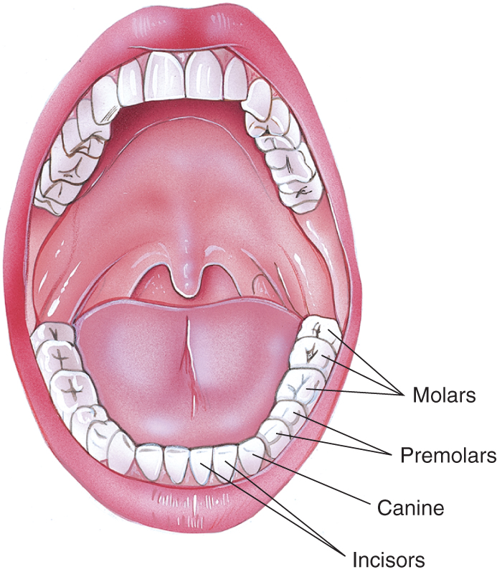
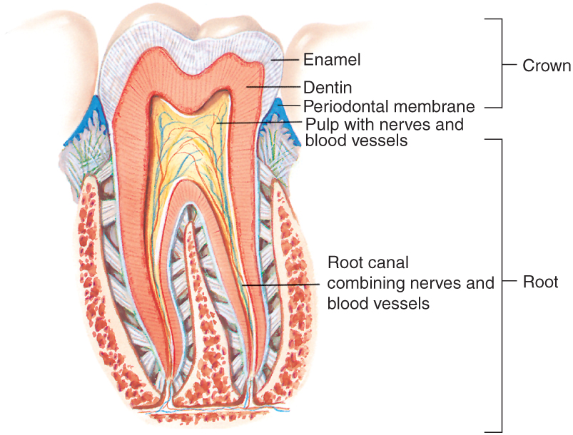
Anatomy and Physiology Review
Assessment begins at the opening of the mouth with the teeth.
© Jones & Bartlett Learning.
© Jones & Bartlett Learning.
Notes:
72
Lecture Outline
B. Anatomy and physiology review
1. Assessment begins at the opening of the mouth with the teeth.

Slide 73
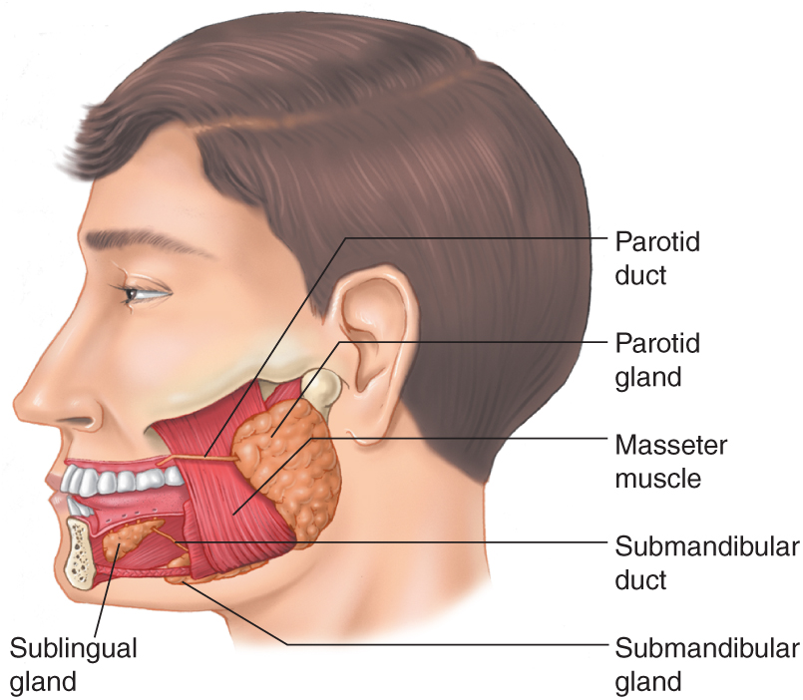
The Mouth
Nerves:
  Hypoglossal
  Glossopharyngeal
  Trigeminal
  Facial
© Jones & Bartlett Learning.
Notes:
73
Lecture Outline
2. Hypoglossal, glossopharyngeal, trigeminal, and facial nerves supply the mouth and its structures.

Slide 74
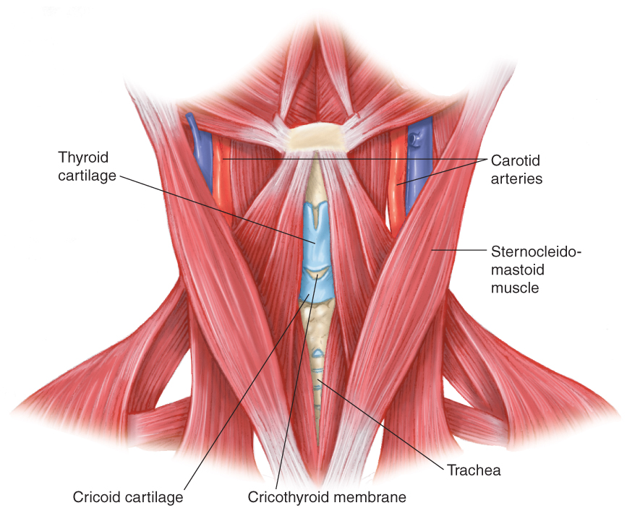
The Neck
Anterior part of the neck includes:
  Thyroid and cricoid cartilage
  Trachea
  Muscles and nerves
© Jones & Bartlett Learning.
Notes:
74
Lecture Outline
3. The neck consists of the anterior and posterior portions.
a. The anterior part of the neck includes:
i. Thyroid and cricoid cartilage
ii. Trachea
iii. Numerous muscles and nerves

Slide 75
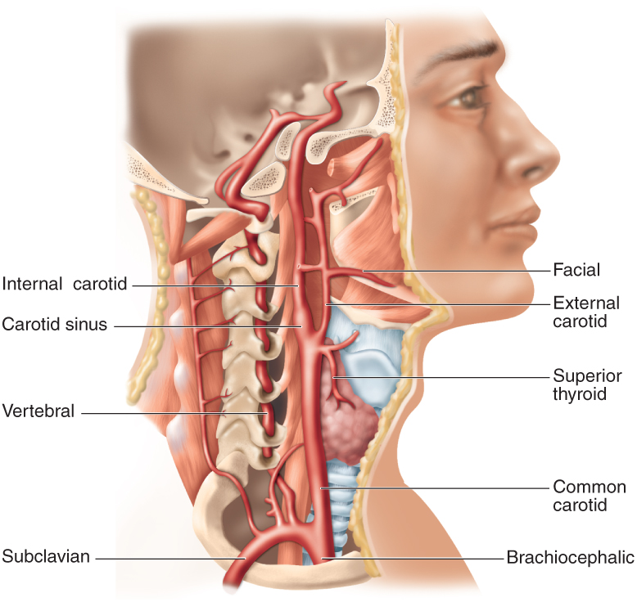
The Neck
Major blood vessels
  Internal and external carotid arteries
  Internal and external jugular veins
© Jones & Bartlett Learning.
Notes:
75
Lecture Outline
iv. Major blood vessels
(a) Internal and external carotid arteries
(b) Internal and external jugular veins
b. Vertebral arteries run laterally to the cervical vertebrae in the posterior part of the neck.

Slide 76
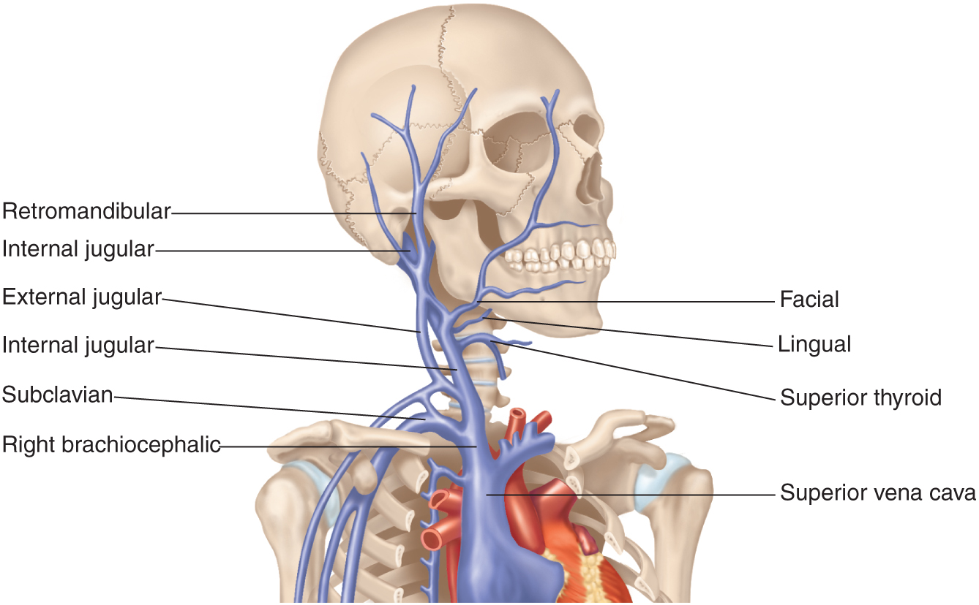
The Neck
© Jones & Bartlett Learning.
Notes:
This figure shows the veins of the neck.

Slide 77
Patient Assessment
Swallowing abnormalities require a position to allow drainage.
  Lateral recumbent or recovery position
Assessments should consider epiglottitis if there are symptoms of:
  Sore throat
  Drooling
  A forward-hanging head
Notes:
77
Lecture Outline
C. Patient assessment
1. Patients with swallowing abnormalities or copious mucous production should be placed in a position to allow drainage.
a. Lateral recumbent or recovery position
2. Assessing stroke patients must include early recognition of airway threats.
3. For patients who cannot protect their airways and are at risk for aspiration into the lungs, intubation should be considered.
4. In your assessments, you should consider epiglottitis if there are symptoms of:
a. Sore throat
b. Drooling
c. A forward-hanging head

Slide 78
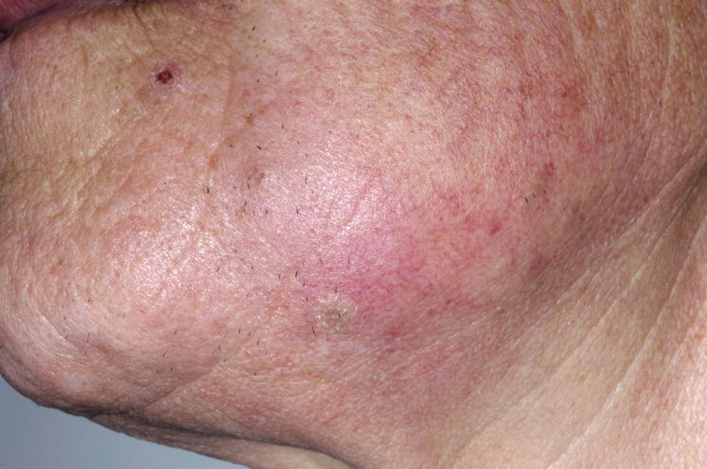
Dentalgia and Dental Abscess
Dentalgia: toothache
Dental abscess
  Bacteria growth spreads into the gums, facial tissue, bones, and/or neck
© Dr. P. Marazzi/Photo Researchers, Inc.
Notes:
78
Lecture Outline
D. Pathophysiology, assessment, and management of specific throat conditions
1. Dentalgia and dental abscess
a. Dentalgia (toothache) can be the start of a dental abscess.
i. A dental abscess occurs when bacteria growth spreads directly from a cavity into the gums, facial tissue, bones, and/or neck.
ii. It may have to be drained surgically.

Slide 79
Dentalgia and Dental Abscess
Assessment and management
  Infection may become systemic.
  An abscess in the throat, neck, or under the tongue can affect the patient’s ability to breathe.
  Prehospital treatment is aimed at relieving symptoms.
Notes:
79
Lecture Outline
b. Assessment and management
i. Infection may have become systemic if the patient has:
(a) Fever
(b) Chills
(c) Nausea
(d) Vomiting
ii. An abscess in the throat, neck, or under the tongue can affect the ability to breathe.
iii. Prehospital treatment is aimed at relieving the symptoms.
(a) Drainage into the mouth should be rinsed with warm water.
iv. Encourage transport.

Slide 80
Diseases of Oral Soft Tissue
Can be the root cause of other health problems
Include:
  Cold sores
  Canker sores
  Thrush
  Leukoplakia
  Gingivitis
  Bad breath
Notes:
80
Lecture Outline
2. Diseases of oral soft tissue
a. Can be root cause of other health problems
i. Gum disease has been linked to heart disease, stroke, diabetes, and osteoporosis.
b. Some common mouth disorders:
i. Cold sores
(a) Painful sores on the lips and around the mouth
ii. Canker sores
(a) Shallow, painful ulcers in the mouth
iii. Oral candidiasis (thrush)
(a) Yeast infection that causes white patches in the mouth or on the oral mucosa
iv. Leukoplakia
(a) Causes excess cell growth in mouth, cheek, or gums
(b) Presents as white patches
v. Gingivitis
(a) Red swollen gums
vi. Bad breath
(a) Usually linked to plaque and poor oral hygiene

Slide 81
Diseases of Oral Soft Tissue
Assessment and management
  Rule out urticaria and allergic reactions.
Notes:
81
Lecture Outline
c. Assessment and management
i. Rule out urticaria and allergic reactions.

Slide 82
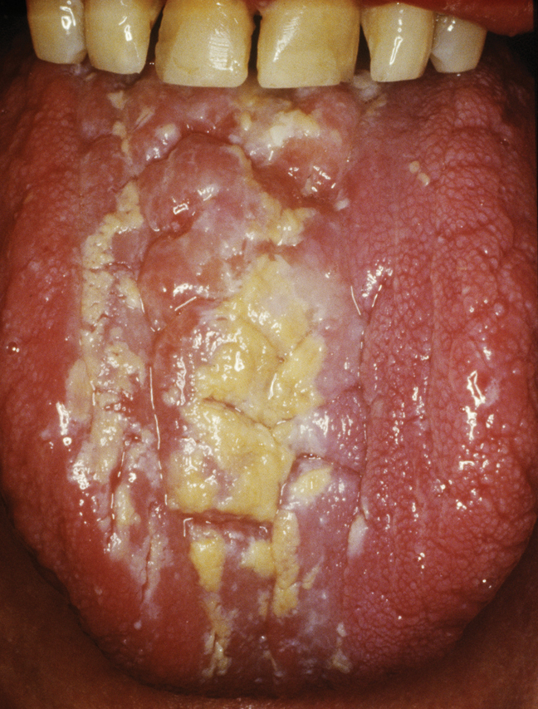
Oral Candidiasis (Thrush)
Candida albicans accumulates on the lining of the mouth.
The patient will have creamy white lesions.
  May be painful and bleed if scraped
© Biophoto Associates/Photo Researchers, Inc.
Notes:
82
Lecture Outline
3. Oral candidiasis (thrush)
a. Condition in which the fungus Candida albicans accumulates on the lining of the mouth
b. Creamy white lesions on the tongue and inner cheeks
i. May be painful and may bleed as they are rubbed or scraped

Slide 83
Oral Candidiasis (Thrush)
Assessment and management
  Most likely to be found in:
    Babies
    Patients with compromised immune systems
    Patients who wear dentures
    Patients who use inhaled corticosteroids
Notes:
83
Lecture Outline
c. Assessment and management
i. Thrush is most likely to be found in:
(a) Babies
(b) Patients with compromised immune systems
(c) Patients who wear dentures
(d) Patients who use inhaled corticosteroids

Slide 84
Oral Candidiasis (Thrush)
Assessment and management (cont’d)
  Additional symptoms may include:
    Cracking and redness at the corners of the mouth
    Cottony feeling in the mouth
    Sensation of food stuck in the throat
Notes:
84
Lecture Outline
ii. Additional symptoms include:
(a) Pain
(b) Cracking and redness at the corners of the mouth
(c) Loss of taste
(d) Cottony feeling in the mouth
(e) In severe cases, lesions can move down the esophagus, causing the sensation that food is getting stuck in the throat when swallowing.

Slide 85
Oral Candidiasis (Thrush)
Assessment and management (cont’d)
  Patients at increased risk include those with:
    HIV/AIDS
    Cancer
    Diabetes
    Vaginal yeast infections
  Treat higher priorities.
  Make the patient comfortable.
Notes:
85
Lecture Outline
iii. Patients at increased risk have a medical history of:
(a) HIV/AIDS
(b) Cancer
(c) Diabetes
(d) Vaginal yeast infections
iv. Treat higher priorities.
v. Make the patient comfortable.
vi. Encourage the patient to follow up with a physician.
vii. Always use standard precautions.

Slide 86
Ludwig Angina
Ludwig angina is a type of cellulitis caused by bacteria from an infected tooth root or mouth injury.
  Occurs under the tongue
A physical exam may show redness and swelling of the neck or under the chin.
Notes:
86
Lecture Outline
4. Ludwig angina
a. Type of cellulitis caused by bacteria from an infected tooth root or mouth injury
b. Occurs on the floor of the mouth under the tongue
c. Rapid swelling and airway obstruction
d. Redness and swelling of the neck or under the chin
i. Tongue may be swollen.
e. An airway through the nasal passages possibly needed

Slide 87
Ludwig Angina
Assessment and management
  Symptoms may include:
    Difficulty breathing or swallowing
    Neck pain and swelling
    Fever
    Drooling
    Altered speech sounds
Notes:
87
Lecture Outline
f. Assessment and management
i. Symptoms may include:
(a) Difficulty breathing
(b) Difficulty swallowing
(c) Neck pain
(d) Neck swelling
(e) Fever
(f) Drooling
(g) Altered speech sounds

Slide 88
Ludwig Angina
Assessment and management (cont’d)
  Prehospital treatment requires aggressive management of the airway in severe cases.
  Contact medical control physician early on.
  Attend to basic ABCs.
Notes:
88
Lecture Outline
ii. Prehospital treatment requires aggressive management of the airway in severe cases.
iii. Contact medical control physician early on.
iv. Remain calm and organized.
v. Attend to basic ABCs.
vi. Pay particular attention to the condition and smells originating in the mouth.

Slide 89
Epiglottitis
Inflammation of the epiglottis
  Blocks the trachea and obstructs the airway
  Often result of the Haemophilus influenzae type b virus
Notes:
89
Lecture Outline
5. Epiglottitis
a. Inflammation of the epiglottis
i. Blocks the trachea and obstructs the airway
ii. Often result of the Haemophilus influenzae type b virus

Slide 90
Epiglottis
Assessment and management
  Symptoms may include:
    Fever
    Sore throat
    Painful swallowing
    Stridor
  Signs may include:
    Sick and anxious
    Tripod position or sniffing position
    Increased work of breathing
    Pallor or cyanosis
Notes:
Lecture Outline
b. Assessment and management
i. Symptoms include:
(a) Fever
(b) Sore throat
(c) Painful swallowing
(d) Stridor
(e) Respiratory distress
ii. Signs include:
(a) Patient will look sick and anxious.
(b) Patient will sit upright in the classic tripod position or in the sniffing position.
(c) Patient may be drooling.
(d) Work of breathing is increased.
(e) Pallor or cyanosis may be evident.

Slide 91
Epiglottitis
Assessment and management (cont’d)
  Transport to an appropriate hospital.
    Minimize scene time.
    Do not agitate the patient.
    Do not attempt to look in the mouth.
    Alert receiving personnel.
Notes:
91
Lecture Outline
iii. Transport to an appropriate hospital while maintaining the airway.
(a) Minimize scene time.
(b) Do not attempt procedures that might agitate the patient.
(c) Do not attempt to look in the mouth.
(d) Alert receiving personnel of suspected diagnosis and patient’s condition.

Slide 92
Laryngitis
Swelling and inflammation of the larynx
Causes may include:
  Overuse
  Pneumonia
  Irritants and chemicals
  Bronchitis
  Allergies
Notes:
92
Lecture Outline
6. Laryngitis
a. Swelling and inflammation of larynx associated with hoarseness or loss of voice
b. Can be the result of overuse
c. Most common form caused by a virus
i. Can also be caused by:
(a) Pneumonia
(b) Irritants
(c) Chemicals
(d) Gastroesophageal reflux disease
(e) Bronchitis
(f) Allergies
(g) Bacterial infections

Slide 93
Laryngitis
Assessment and management
  Symptoms include:
    Fever
    Hoarseness
    Swollen lymph nodes or glands
  Consider a fracture of the hyoid bone.
  Have the patient follow up with a physician.
Notes:
93
Lecture Outline
d. Assessment and management
i. Symptoms include:
(a) Fever
(b) Hoarseness
(c) Swollen lymph nodes or glands in the neck
ii. Obtain a good history to rule out evolving upper airway obstruction or an allergic reaction.
iii. Consider fracture of the hyoid bone.
iv. Have the patient follow up with a physician.

Slide 94
Tracheitis
Bacterial infection of the trachea caused by Staphylococcus aureus
  Frequently occurs in children following upper respiratory infection
  Trachea easily blocked by swelling
  Can be life threatening
Notes:
94
Lecture Outline
7. Tracheitis
a. Bacterial infection of the trachea caused by Staphylococcus aureus
b. Frequently occurs in young children following a viral upper respiratory infection
i. The trachea is easily blocked by swelling.
ii. It can be a life-threatening condition.

Slide 95
Tracheitis
Assessment and management
  Symptoms
    Croup-like cough
    Difficulty breathing
    High fever
  Signs
    Tripod positioning
    Intercostal retractions
Notes:
95
Lecture Outline
c. Assessment and management
i. Symptoms include:
(a) Deep croup-like cough
(b) Difficulty breathing
(c) High fever
(d) High-pitched stridor with breathing
ii. Patients may exhibit:
(a) Tripod positioning
(b) Intercostal retractions
(c) Can proceed from respiratory distress to respiratory failure if not addressed

Slide 96
Tracheitis
Prehospital care is supportive.
  Minimize stress to the patient.
  Administer 100% oxygen.
  Use pulse oximetry.
  Monitor vital signs.
  Be prepared for difficult intubation.
  Transport promptly.
Notes:
96
Lecture Outline
iii. Supportive prehospital care
(a) Minimize stress to the patient.
(b) Administer 100% oxygen.
(c) Use pulse oximetry.
(d) Monitor vital signs.
(e) Be prepared for difficult intubation.
(1) Have the correct size ET tube as well as the next smaller size available.
(f) Transport promptly to an appropriate facility.

Slide 97
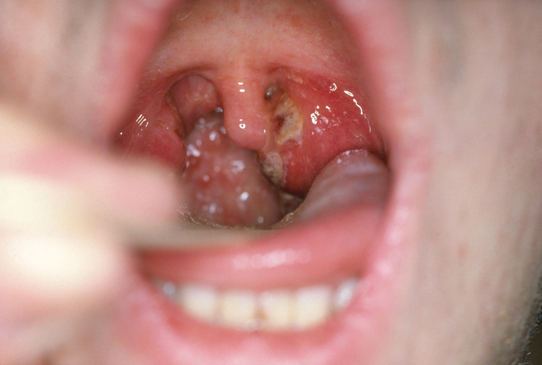
Tonsillitis
Swelling and inflammation of tonsils
Usually caused by viral infections
  Can also be caused by bacteria
© Biophoto Associates/Photo Researchers, Inc.
Notes:
97
Lecture Outline
8. Tonsillitis
a. Swelling and inflammation of the tonsils (oval-shaped pads of tissue at the back of the throat)
b. Usually caused by viral infections
i. Can also be caused by bacteria

Slide 98
Tonsillitis
Assessment and management
  Symptoms:
    Swollen tonsils
    Sore throat
    Difficulty swallowing
  Signs:
    Red, swollen tonsils
    White or yellow coating or patches
    Fever
    Sore throat
Notes:
Lecture Outline
c. Assessment and management
i. Symptoms include:
(a) Swollen tonsils
(b) Sore throat
(c) Difficulty swallowing
ii. Patients will present with the following:
(a) Red, swollen tonsils
(b) White or yellow coating or patches on the tonsils
(c) Fever
(d) Sore throat
(e) One or more of the following:
(1) Pain when swallowing
(2) Enlarged or tender lymph nodes in the neck
(3) Bad breath
(4) Headache
(5) Stiff neck
(6) Drooling
iii. Transport for further evaluation.

Slide 99
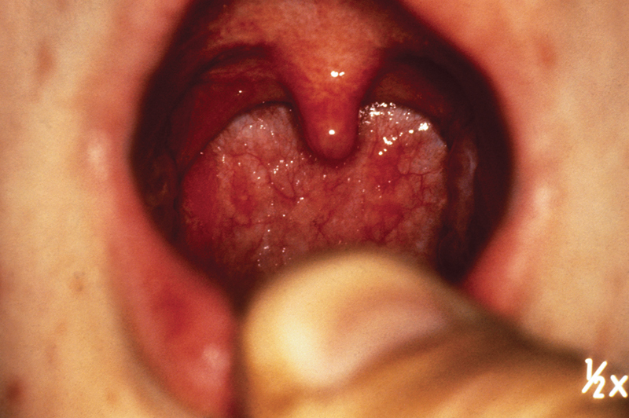
Pharyngitis
Inflammation of the pharynx
Often due to a rapid onset of sore throat
  No discomfort or pain with swallowing
© BSIP/Photo Researchers, Inc.
Notes:
99
Lecture Outline
9. Pharyngitis
a. Inflammation of the pharynx
b. Often due to a rapid onset of sore throat without discomfort or pain with swallowing

Slide 100
Pharyngitis
Assessment and management
  Symptoms may include:
    Fever, headache
    Pharyngeal erythema
    Purulent, patchy yellow, gray, or white exudate
    Ulcers on the soft palate
  Follow-up with the emergency department
Notes:
100
Lecture Outline
c. Assessment and management
i. Symptoms include:
(a) Fever
(b) Pharyngeal erythema
(c) Headache
(d) Purulent, patchy yellow, gray, or white exudate
(e) Nasal congestion
(f) Hoarseness
(g) Cough
(h) Ulcers on the soft palate
ii. Treatment involves follow-up with the emergency department.
iii. A major prehospital concern is assessment for partial airway obstruction.

Slide 101
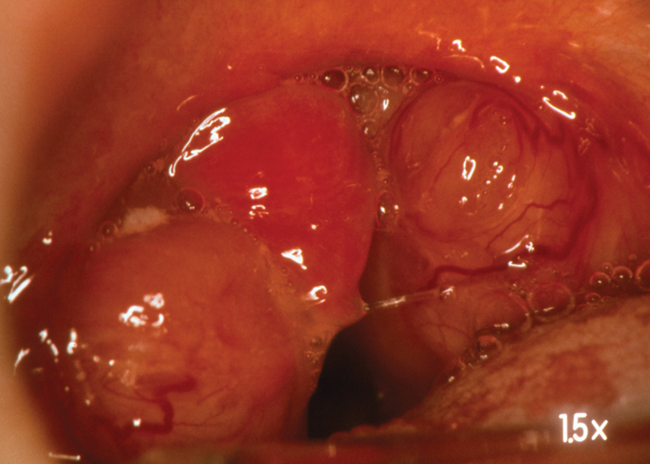
Peritonsillar Abscess
Collection of infected material around the tonsils
Complication of tonsillitis
© Dr. P. Marazzi/Photo Researchers, Inc.
Notes:
101
Lecture Outline
10. Peritonsillar abscess
a. Collection of infected material around the tonsils
b. Complication of tonsillitis

Slide 102
Peritonsillar Abscess
Assessment and management
  One or both tonsils are infected.
  Symptoms include the following:
    Difficulty and pain opening the mouth
    Facial swelling
    Inability to swallow
    Tender glands of the jaw and throat
Notes:
102
Lecture Outline
c. Assessment and management
i. One or both tonsils are infected
ii. Roof of the mouth and neck or chest may be infected.
iii. Patient may have:
(a) Chills
(b) Difficulty opening the mouth
(c) Pain with opening the mouth
(d) Facial swelling
(e) Fever
(f) Drooling or inability to swallow saliva
(g) Headache
(h) Muffled voice
(i) Sore throat
(j) Tender glands of the jaw and throat

Slide 103
Peritonsillar Abscess
Treatment involves antibiotics and draining the abscess.
  Treatment may include tonsillectomy.
  Transport the patient to the hospital.
Notes:
103
Lecture Outline
iv. Antibiotics and draining the abscess
(a) May include tonsillectomy
v. Hospital transport
(a) In some cases, condition may be life threatening.

Slide 104
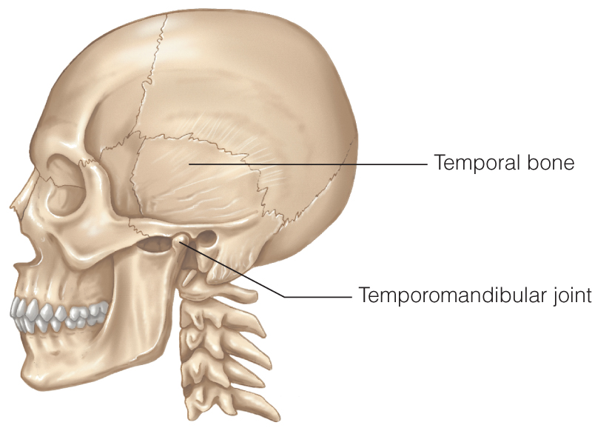
Temporomandibular Joint Disorders
Causes include:
  Arthritis damage to the joint’s cartilage
  Jaw injury
  Jaw muscle fatigue from grinding or clenching of the teeth
© Jones & Bartlett Learning.
Notes:
104
Lecture Outline
11. Temporomandibular joint disorders
a. Temporomandibular joint (TMJ): Where the posterior condyle of the mandible articulates with the temporal bone
i. Allows movement of the mandible
ii. Allows a patient to talk, chew, and yawn
b. Causes of temporomandibular joint disorders include:
i. Arthritis damage to the joint’s cartilage
ii. Jaw injury
iii. Jaw muscle fatigue from grinding or clenching of the teeth

Slide 105
Temporomandibular Joint Disorders
Assessment and management
  Symptoms may include:
    Headache
    Jaw pain
    Difficulty chewing
    Locking of the joint
  Managed by a physician or dentist
Notes:
105
Lecture Outline
c. Assessment and management
i. Symptoms include:
(a) Headache
(b) Jaw pain
(c) Aching around the ear
(d) An uneven bite and/or painful bite
(e) Difficulty chewing
(f) Locking of the joint causing difficulty either opening or closing the mouth
ii. Usually managed by the patient’s physician or dentist

